Slide 1
Railway Reservation Management System
BY:- TRAPTI KASHYAP
MCA iii Sem
2301730140034

Slide 2
INTRODUCTION
The Railway Reservation Management System is a web-based application designed to transform the traditional railway ticketing and reservation process into an efficient, automated, and user-friendly system.
Railway Reservation Management System is an online ticket booking website, which is capable of booking ticket and search the train availability.
The system features a centralized database that securely stores all essential data, including train schedules, ticket availability, booking details, and user profiles. This centralized approach ensures real-time synchronization and accuracy across all operations.

Slide 3
FEATURES OF THE PROJECT
(a) User Authentication
Login: Registered users can securely log in using their email and password to access their accounts.
Signup: New users can easily create accounts by providing required details and setting up their login credentials.
(b) Train Search and Information
Find Trains: Passengers can search for trains by specifying departure and arrival stations along with their travel dates.
Train Details: The system provides comprehensive train information, including schedules, routes, seat availability, and class options.
(c) Reservation and Booking
Seat Selection: Users can choose their preferred seats and select from various seat classes like 1AC, 2AC, 3AC, Sleeper, and General.
Multiple Bookings: The system supports group travel by allowing multiple passenger bookings in a single transaction.
(d) Payment Gateway
Payment Processing: Integration with a secure payment gateway enables smooth online transactions using credit or debit cards.
Card Verification: Users can safely enter their card details for processing payments, including card number, name, expiry date, and CVV.

Slide 4
(e) Booking Confirmation and PNR Generation
Confirmation: Passengers receive a booking confirmation and a unique Passenger Name Record (PNR) upon successful payment.
PNR Tracking: Users can track their booking status or modify their reservations using the PNR.
(f) Booking History
Booking Records: The system maintains a detailed history of all past and upcoming bookings for users to access anytime.
(g) User Profile Management
Profile Updates: Users can manage and update their contact information, preferences, and password through the system.
(h) Admin Panel
User Management: Administrators can manage user accounts, approve or reject registrations, and handle account suspensions.
Booking Oversight: Admins can oversee booking records, address issues, and manage reservation or cancellation processes.

Slide 5
SOFTWARE REQUIREMENTS
Software Requirement for Server:
Web Server - Apache (XAMPP)
Back End - PHP
Front End - HTML, CSS
Operating System - Windows 10 and above
IDE - Visual Studio
Database – PHP MySQL
Software Requirement for Client’s:
Connection - Having well-establish internet connection
Operating System - Windows 10 and above
Web Browser - Chrome, Edge, etc.
HARDWARE REQUIREMENTS
Hardware Requirement for Client’s:
Monitor/Display - 13” LCD monitor
Keyboard - Qwerty
Processor - Dual-Core 2Ghz or higher
Hard Disk - 32GB
Minimum Free Space - 500 MB free disk space
Minimum RAM - 2GB RAM
Hardware Requirement for Server:
Monitor/Display - 13” LCD monitor
Keyboard - Qwerty
Processor - Dual-Core 2Ghz or higher
Hard Disk - 32GB
Minimum Free Space - 500 MB free disk space
Minimum RAM - 2GB RAM

Slide 6
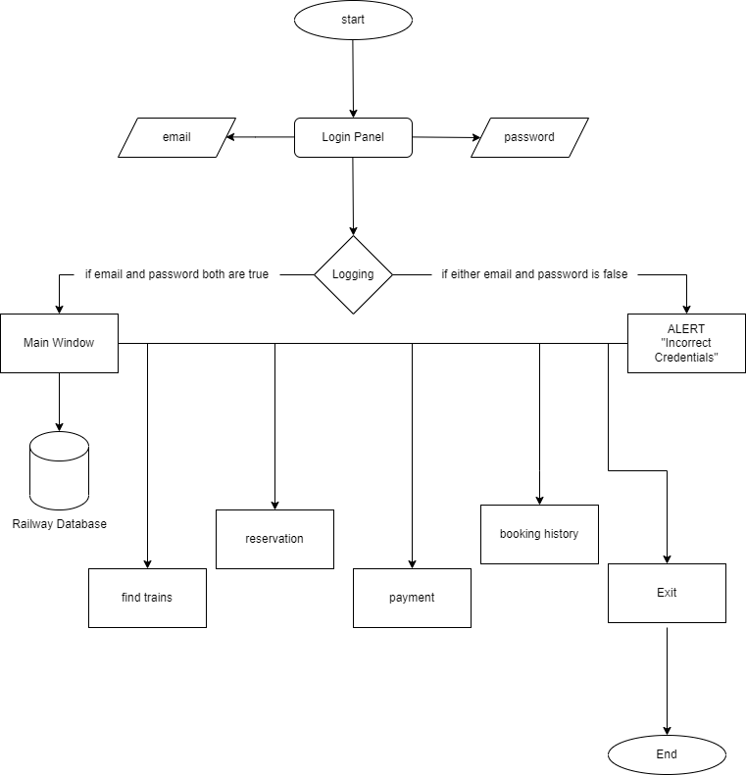
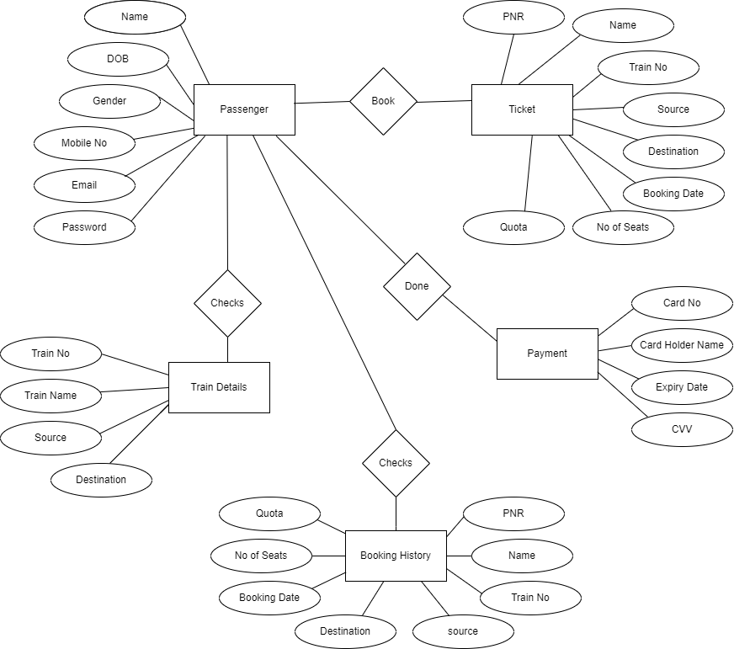
FLOW CHART
ER DIAGRAM

Slide 7
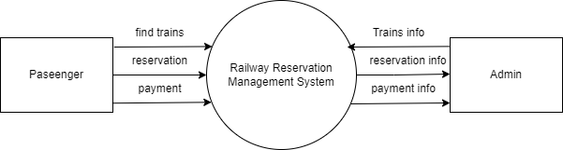
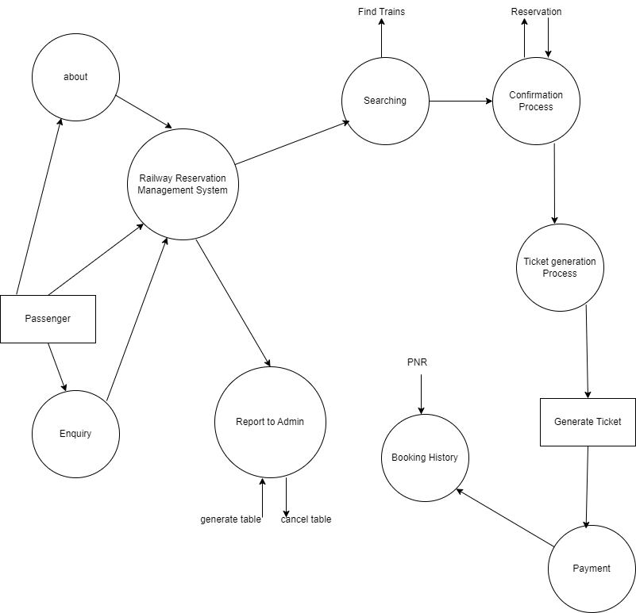
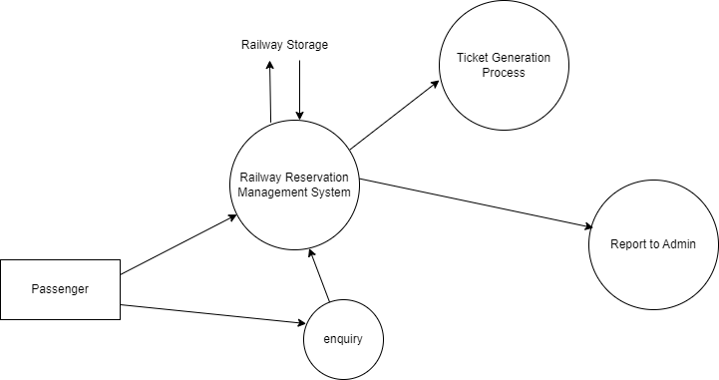
DATA FLOW DIAGRAM

Slide 8
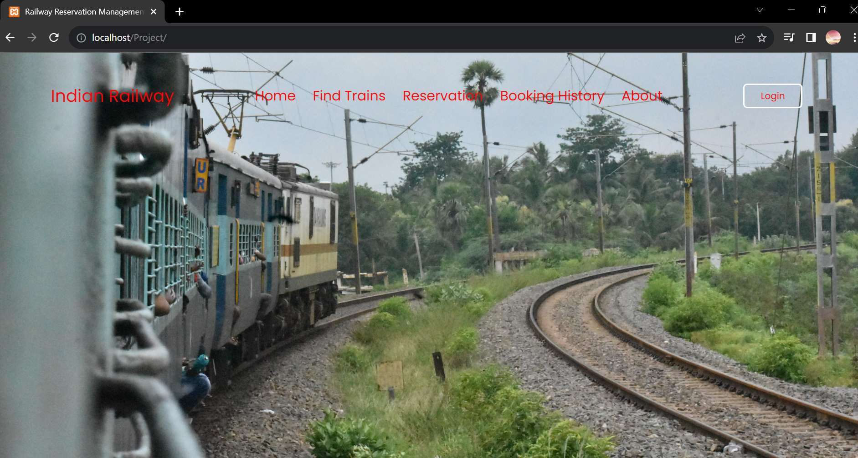
SCREENSHOTS

Slide 9
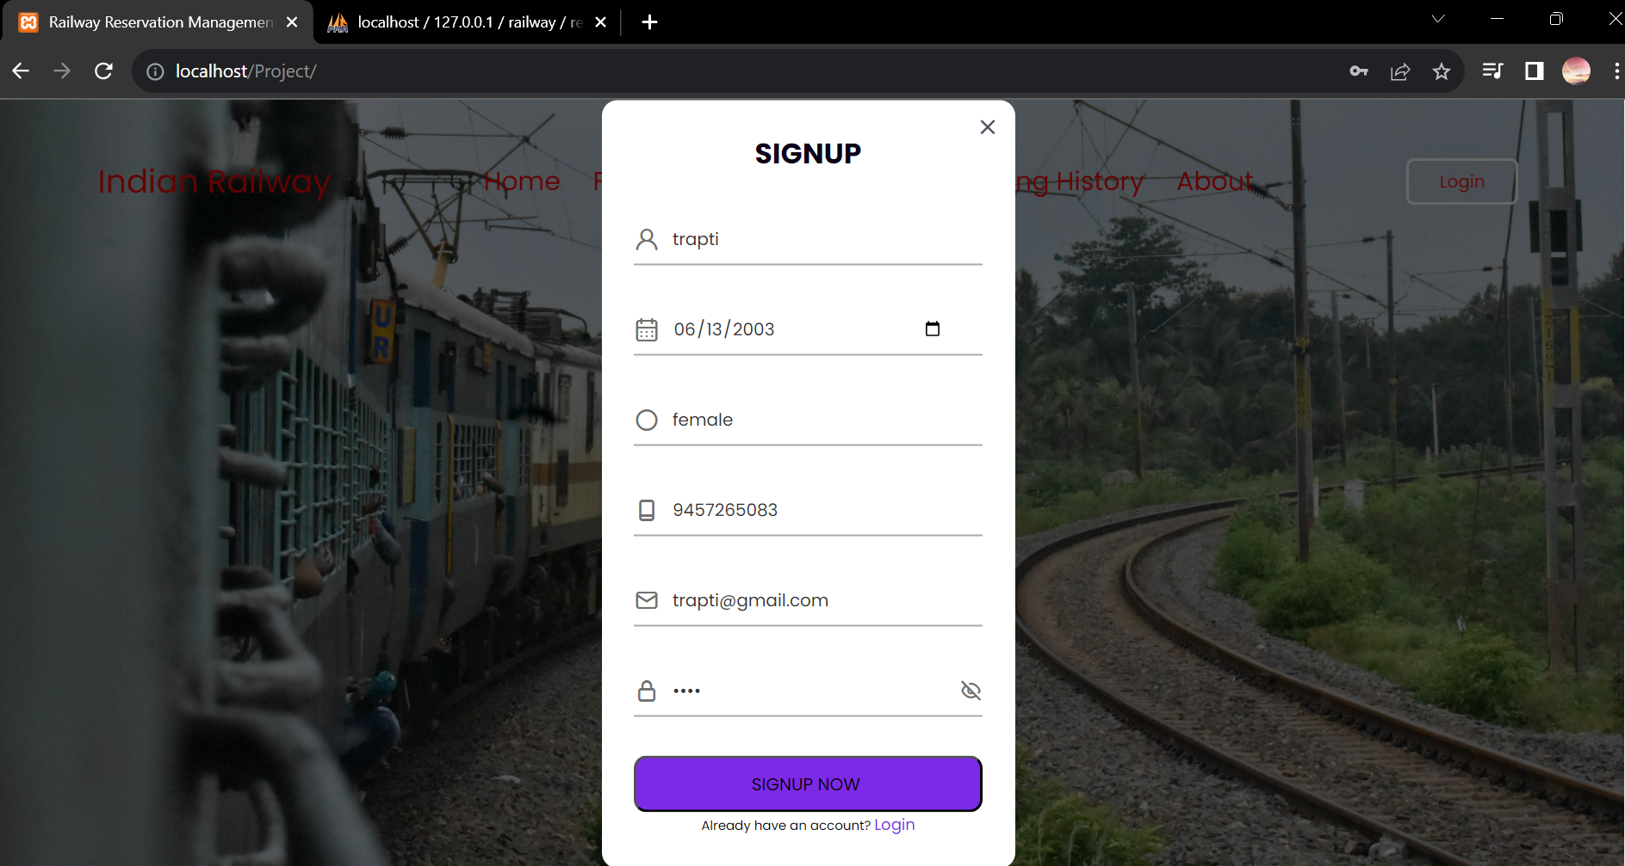
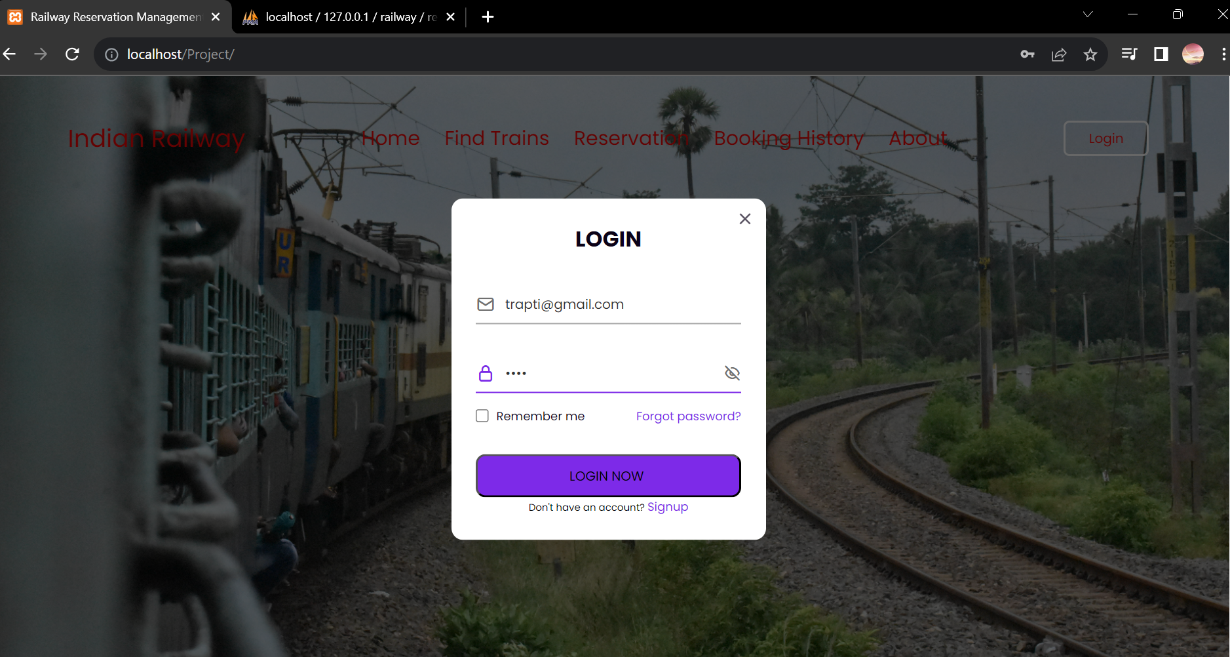
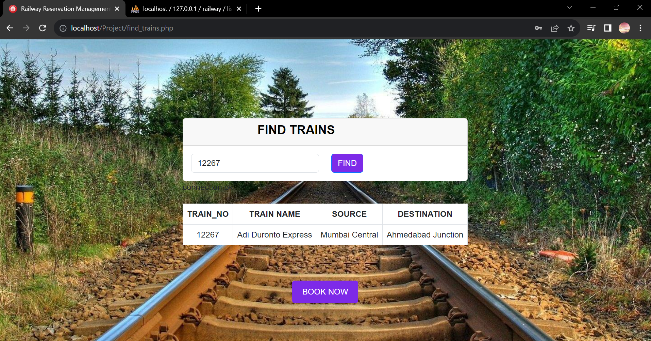

Slide 10
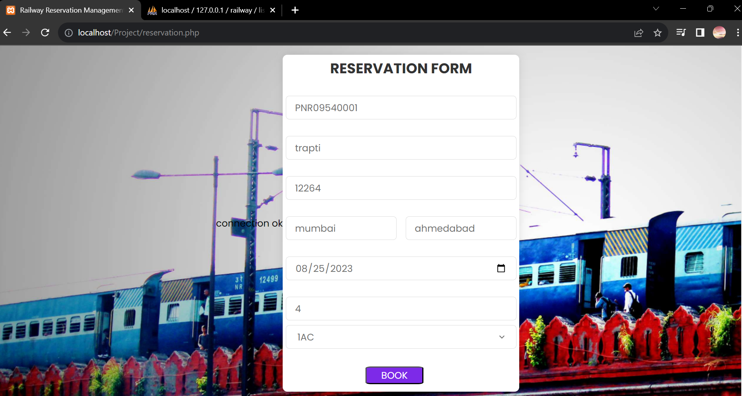
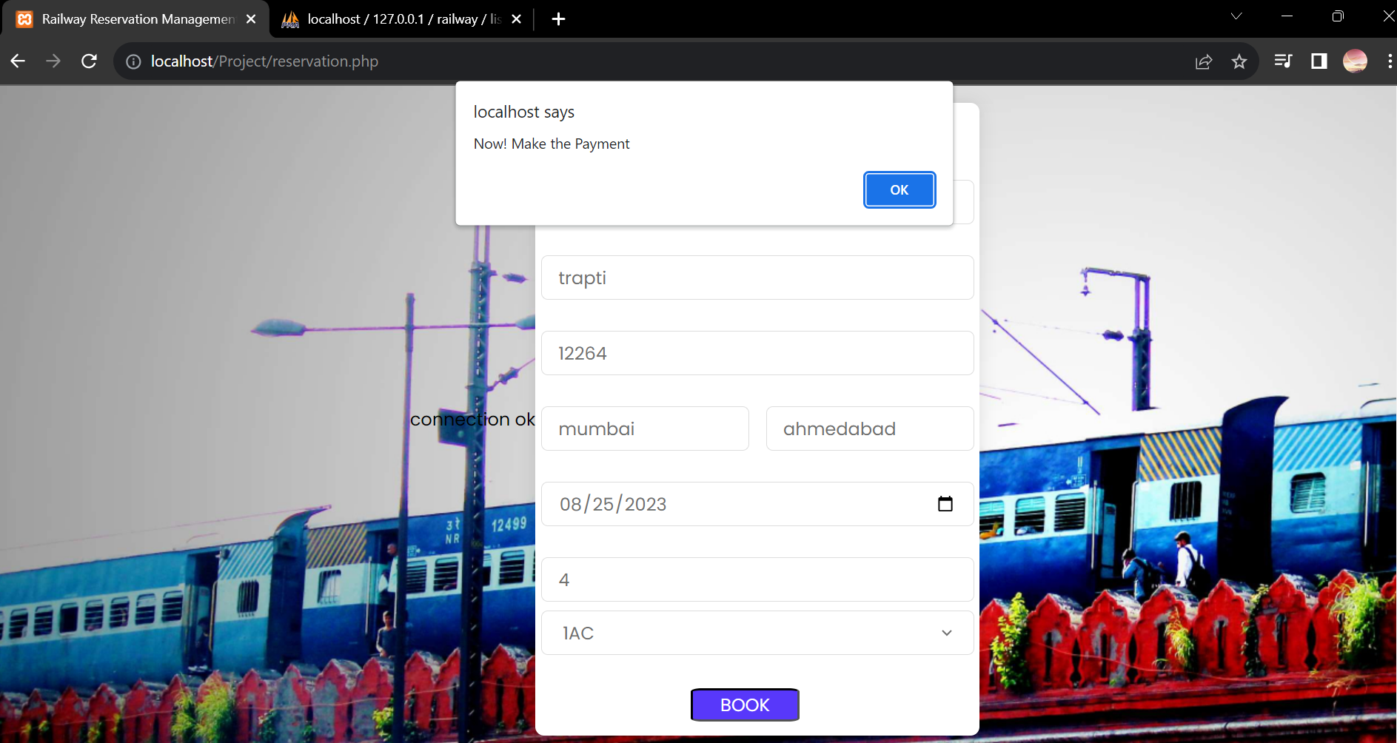
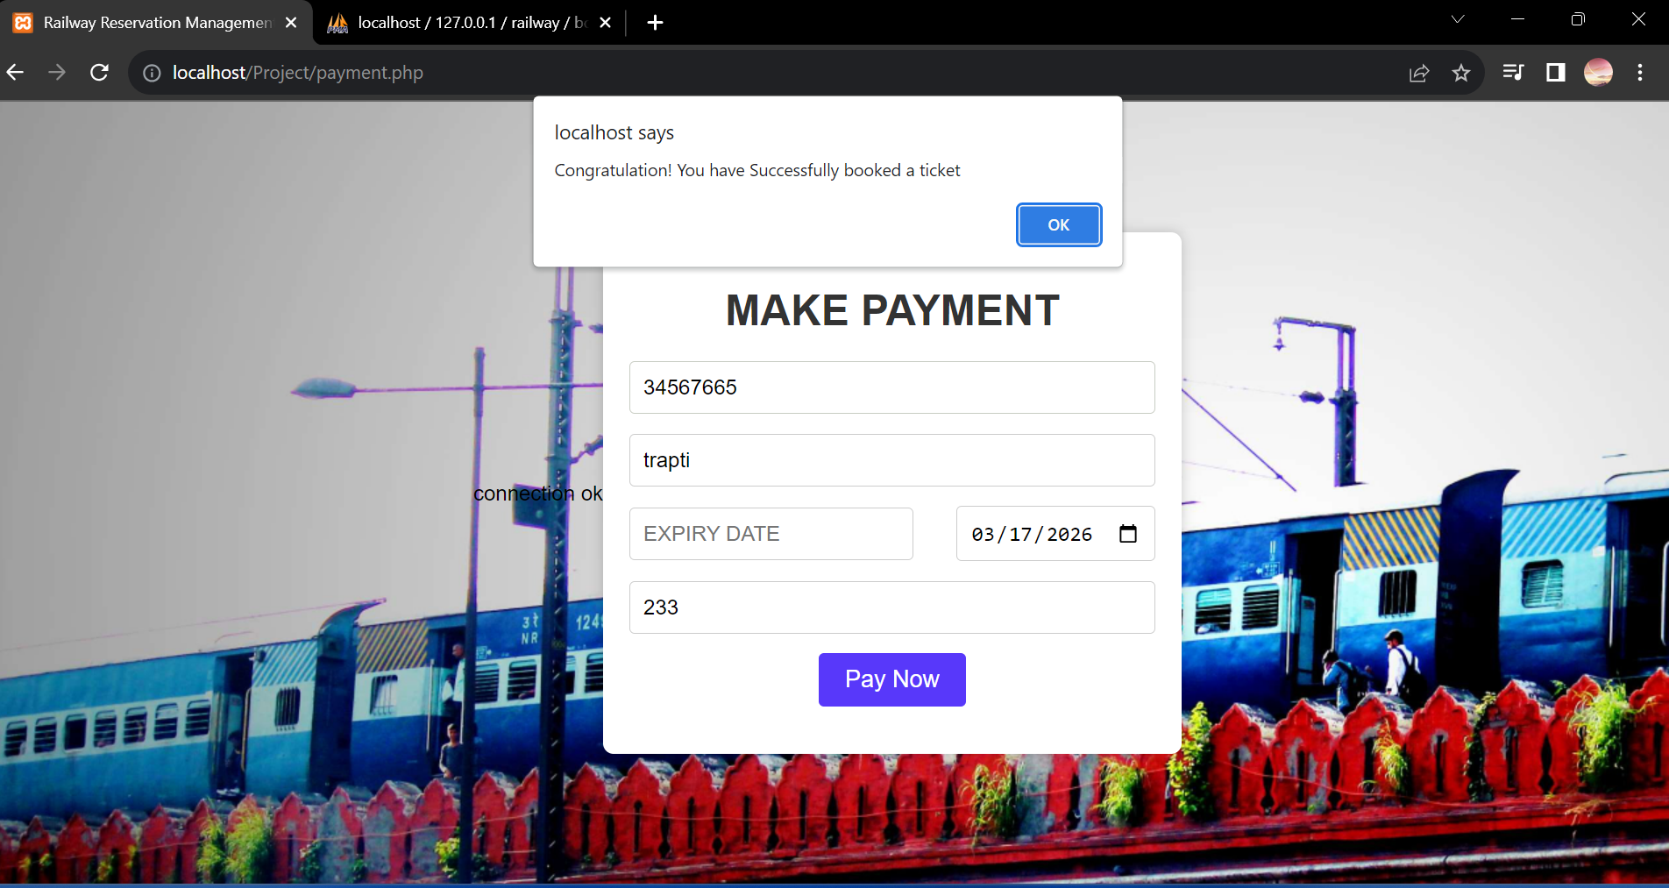

Slide 11
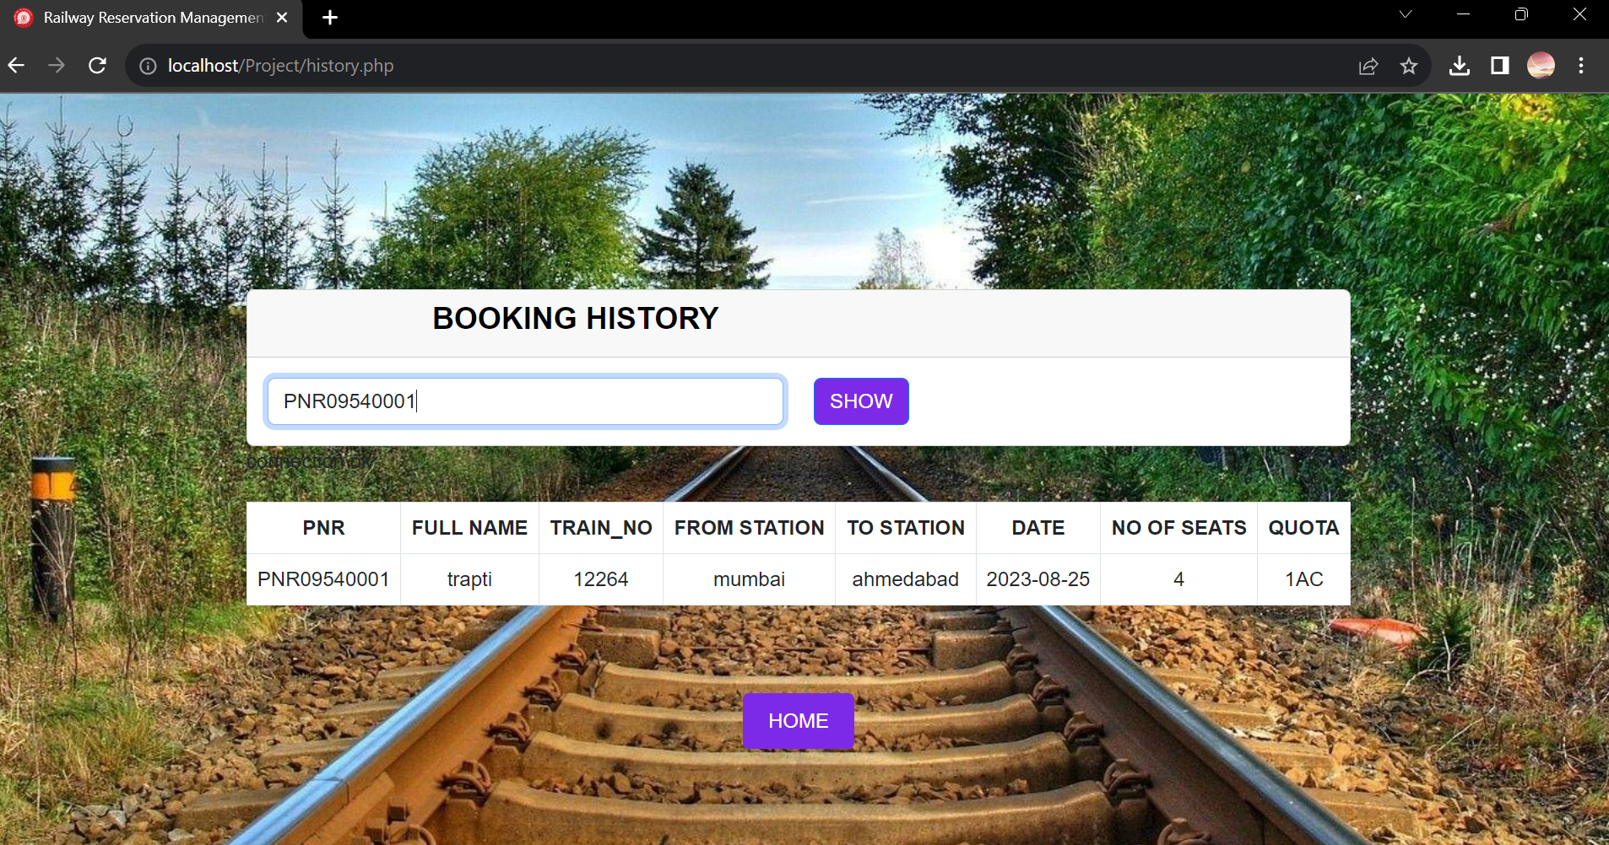
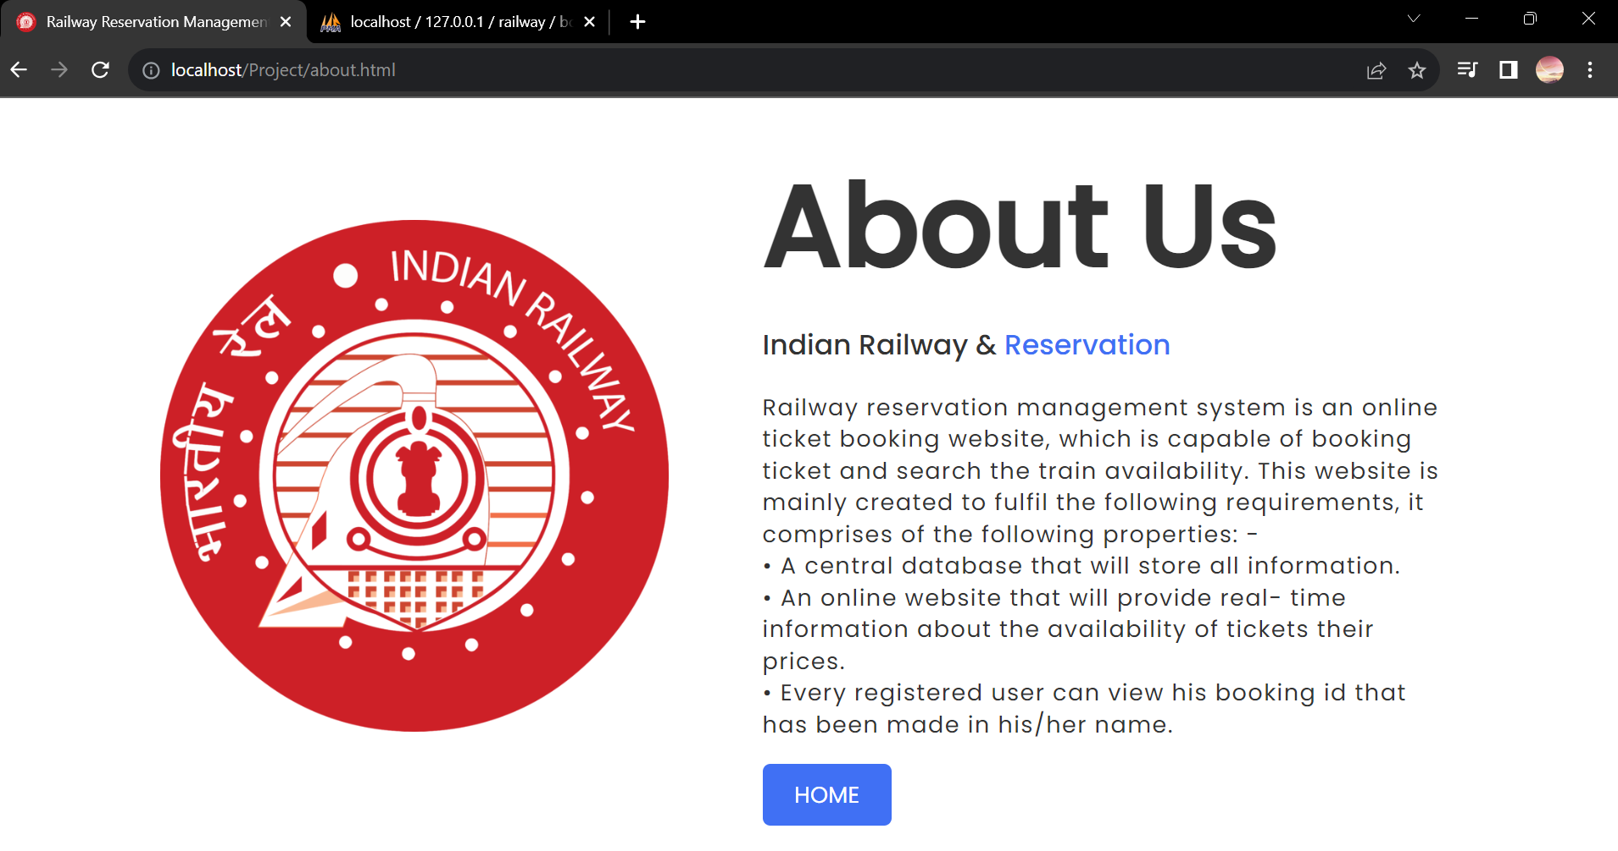
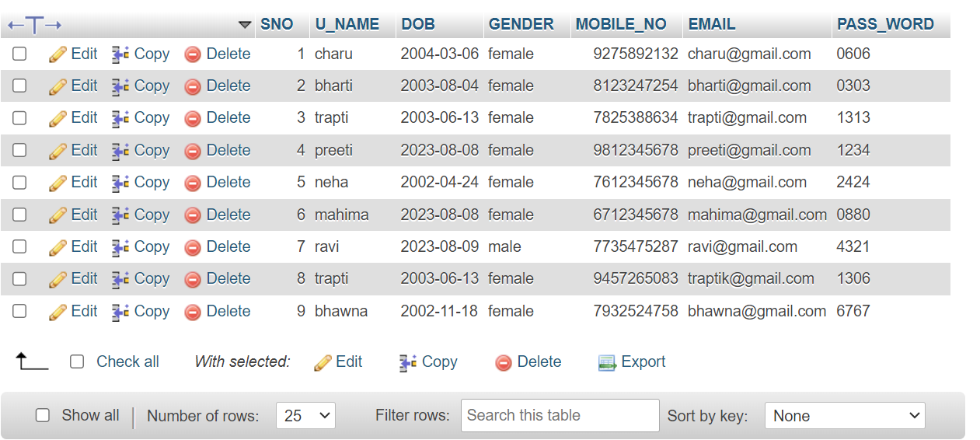
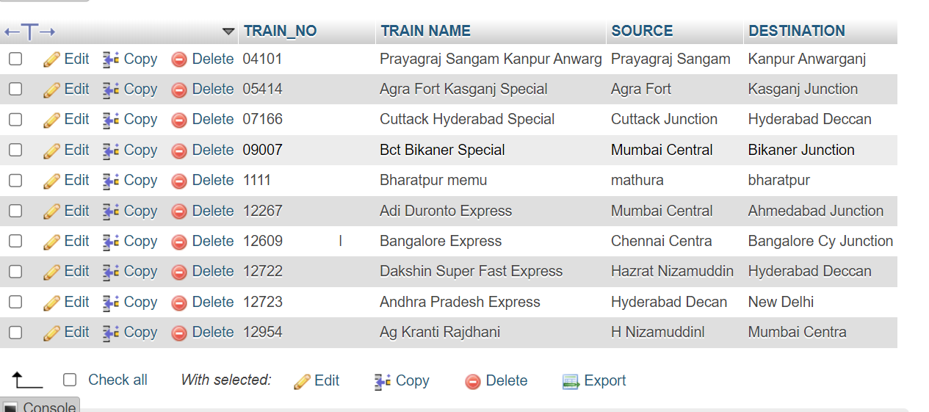

Slide 12
CONCLUSION
In conclusion, the Railway Reservation Management System is an integrated solution that simplifies the entire train reservation process, enhancing user convenience, efficiency, and accessibility. By providing a set of essential modules such as login/signup, train search, reservation, payment handling, and booking history, the system ensures that users can easily and securely manage their travel plans. The modular structure of the system not only enhances usability but also ensures that it is maintainable, scalable, and adaptable for future upgrades or expansions.

Slide 13

Thank you

